Slide 1



Olympics
Dataset Analysis
Sridharan S

Slide 2

Overview
Project Overview
Dataset
Analysis
Conclusion
03
04
05
17

Slide 3


Project Overview
This project involves the analysis of the participation of countries and their athletes in the Olympics from 1896 to 2016 using MySQL as the Database Management System. The objective is to derive meaningful insights into key aspects such as:
Athlete performance.
Country-wise medal tallies.
Trends in sports and events over the years.
Through this analysis, we aim to uncover historical trends, exceptional performances, and country dominance in different sports across the Olympic Games.

Slide 4
Dataset:
The dataset is obtained from an open-source platform (Dataset). It provides comprehensive details on Olympic events over a span of 120 years, from Athens 1896 to Rio 2016.
Key Attributes
Player Details: Unique Player ID, Name, and Gender.
Demographics: Age, Height, Weight.
Country: The country and National Olympic Committee (NOC) they represented.
Participation Details: Year, City, and Season (Summer or Winter).
Sport and Event: The sport and specific event in which they competed.
Medals: Medals won by the athletes (Gold, Silver, Bronze).

Slide 5
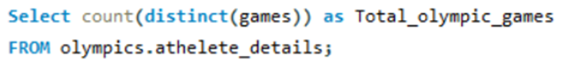
Q 1 :
How many olympics games have been held?
Q 2 :
List down all Olympics games held so far.

Slide 6
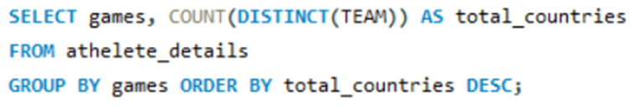
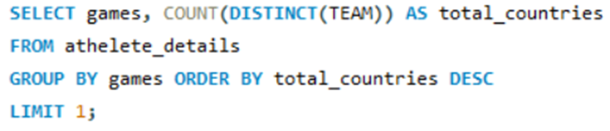
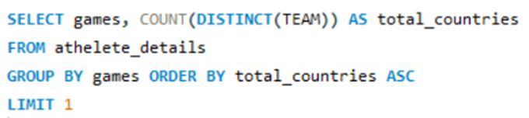
Q 3 :
Mention the total no of nations who participated in each olympics game.
Q 4 :
Which year saw the highest and lowest no of countries participating in Olympics?

Slide 7
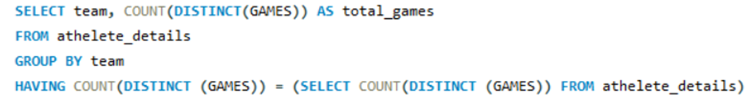
Q 5 :
Which nation has participated in all of the olympic games?

Slide 8
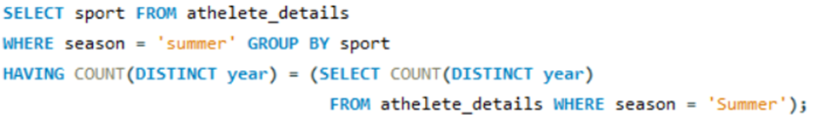
Q 6 :
Identify the sport which was played in all summer olympics.

Slide 9
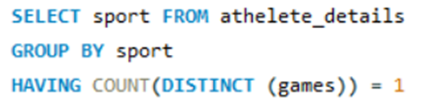
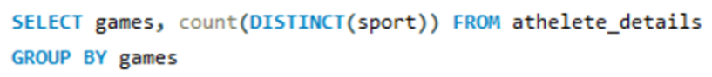
Q 7 :
Which Sports were just played only once in the olympics?
Q 8 :
Fetch the total no of sports played in each olympic games.

Slide 10
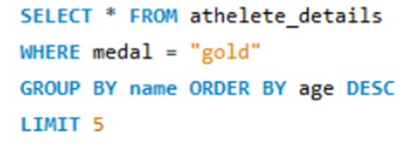
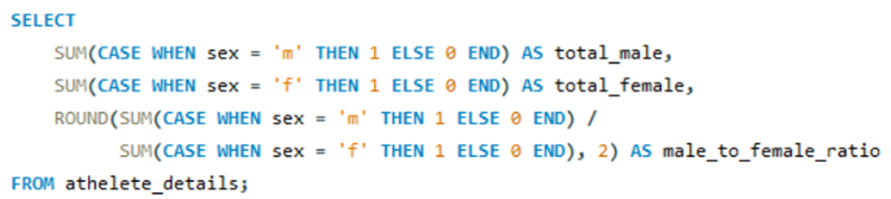
Q 9 :
Fetch oldest athletes to win a gold medal.
Q 10 :
Find the Ratio of male and female athletes participated in all olympic games.

Slide 11
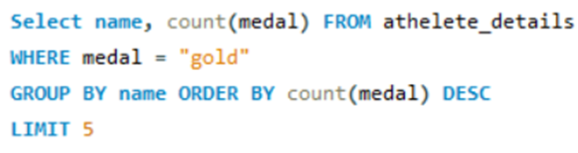
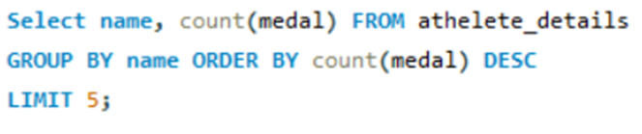
Q 11 :
Fetch the top 5 athletes who have won the most gold medals.
Q 12 :
Fetch the top 5 athletes who have won the most medals (gold/silver/bronze).

Slide 12
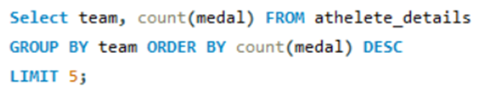
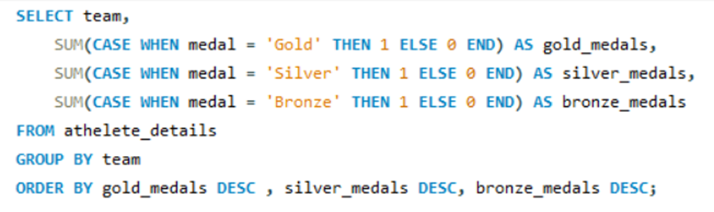
Q 13 :
Fetch the top 5 most successful countries in olympics. Success is defined by no of medals won.
Q 14 :
List down total gold, silver and bronze medals won by each country

Slide 13
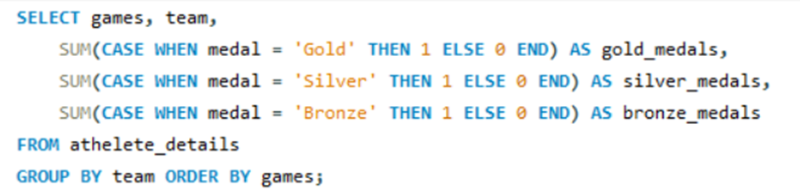
Q 15 :
List down total gold, silver and bronze medals won by each country corresponding to each olympic games.

Slide 14
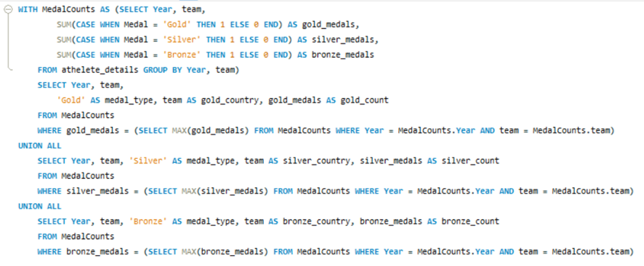
Q 16 :
Identify which country won the most gold, most silver and most bronze medals in each olympic games.

Slide 15
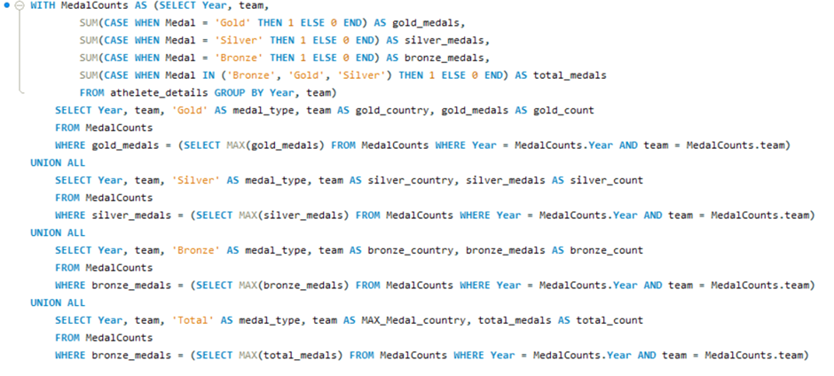
Q 17 :
Identify which country won the most gold, most silver, most bronze medals and the most medals in each olympic games.

Slide 16
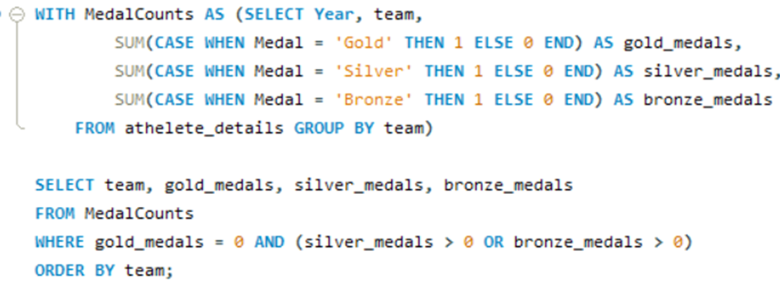
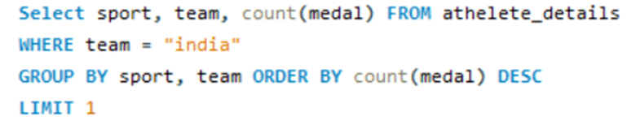
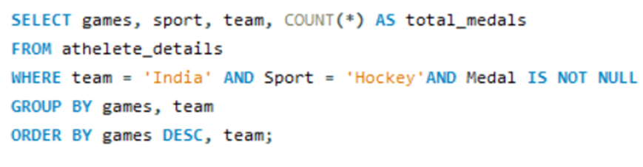
Q 18 :
Which countries have never won gold medal but have won silver/bronze medals?
Q 19 :
In which Sport/event, India has won highest medals.
Q 20 :
Break down all olympic games where India won medal for Hockey and how many medals in each olympic games.

Slide 17
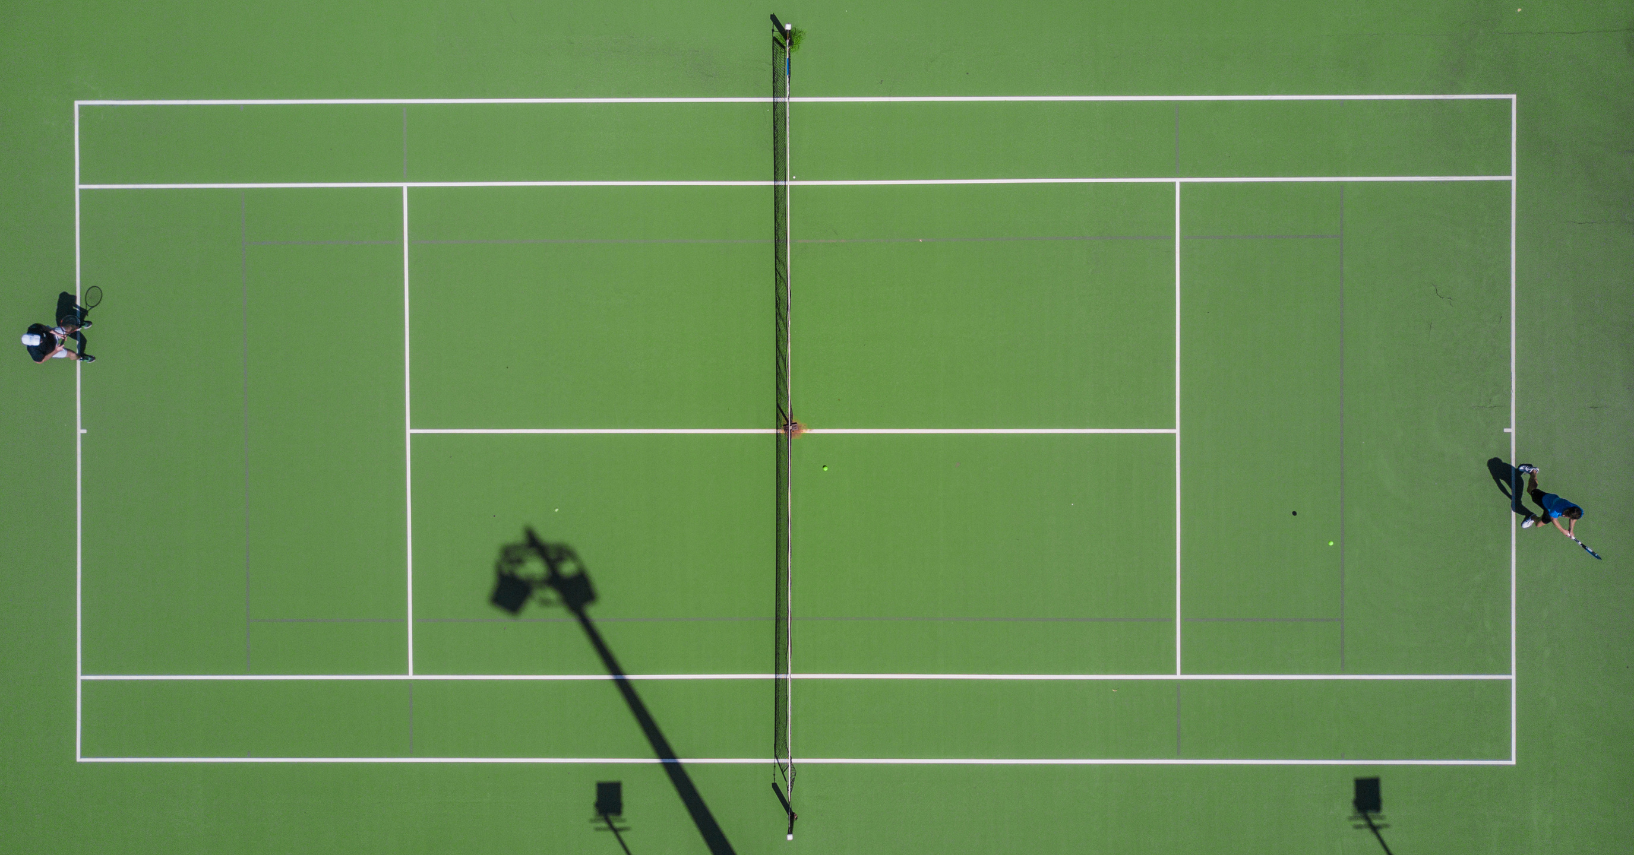
Conclusion
The analysis of Olympic data from 1896 to 2016 highlights the growth of global sports, with increasing participation from countries and athletes.
Dominance by nations like the USA, Russia, and China underscores the impact of investments in sports infrastructure. Trends reveal rising gender inclusivity and evolving preferences in sports.
Exceptional athlete performances and changing medal tallies reflect progress and global diversity. The dataset provides a comprehensive view of the transformative power of sports across countries.

